Slide 1
CE 395R 5- Data Mining Mining Association Rules (Part I)

Slide 2
Association Rule Mining
Given a set of transactions, find rules that will predict the occurrence of an item based on the occurrences of other items in the transaction
Market-Basket transactions
Example of Association Rules
{Diaper} → {Beer}, {Milk, Bread} → {Eggs,Coke}, {Beer, Bread} → {Milk},
Implication means co-occurrence, not causality!

Slide 3
Association Rule Discovery: Application
Marketing and Sales Promotion:
Let the rule discovered be
{Bagels, … } --> {Potato Chips}
Potato Chips as consequent => Can be used to determine what should be done to boost its sales.
Bagels in the antecedent => Can be used to see which products would be affected if the store discontinues selling bagels.
Bagels in antecedent and Potato chips in consequent => Can be used to see what products should be sold with Bagels to promote sale of Potato chips!

Slide 4
Definition: Frequent Itemset
Itemset
A collection of one or more items
Example: {Milk, Bread, Diaper}
k-itemset
An itemset that contains k items
Support count (σ)
Frequency of occurrence of an itemset
E.g. σ({Milk, Bread,Diaper}) = 2
Support
Fraction of transactions that contain an itemset
E.g. s({Milk, Bread, Diaper}) = 2/5
Frequent Itemset
An itemset whose support is greater than or equal to a minsup threshold

Slide 5
Definition: Association Rule
Association Rule
An implication expression of the form X → Y, where X and Y are itemsets
Example: {Milk, Diaper} → {Beer}
Rule Evaluation Metrics
Support (s)
Fraction of transactions that contain both X and Y
Confidence (c)
Measures how often items in Y appear in transactions that contain X
Example:

Slide 6
Association Rule Mining Task
Given a set of transactions T, the goal of association rule mining is to find all rules having
support ≥ minsup threshold
confidence ≥ minconf threshold
Brute-force approach:
List all possible association rules
Compute the support and confidence for each rule
Prune rules that fail the minsup and minconf thresholds
⇒ Computationally prohibitive!

Slide 7
Mining Association Rules
Example of Rules:
{Milk,Diaper} → {Beer} (s=0.4, c=0.67) {Milk,Beer} → {Diaper} (s=0.4, c=1.0)
{Diaper,Beer} → {Milk} (s=0.4, c=0.67)
{Beer} → {Milk,Diaper} (s=0.4, c=0.67) {Diaper} → {Milk,Beer} (s=0.4, c=0.5)
{Milk} → {Diaper,Beer} (s=0.4, c=0.5)
Observations:
All the above rules are binary partitions of the same itemset: {Milk, Diaper, Beer}
Rules originating from the same itemset have identical support but can have different confidence
Thus, we may decouple the support and confidence requirements

Slide 8
Mining Association Rules
Two-step approach:
Frequent Itemset Generation
Generate all itemsets whose support ≥ minsup
Rule Generation
Generate high confidence rules from each frequent itemset, where each rule is a binary partitioning of a frequent itemset
Frequent itemset generation is still computationally expensive

Slide 9
Frequent Itemset Generation
Given d items, there are 2^{d} possible candidate itemsets

Slide 10
Frequent Itemset Generation
Brute-force approach:
Each itemset in the lattice is a candidate frequent itemset
Count the support of each candidate by scanning the database
Match each transaction against every candidate

Slide 11
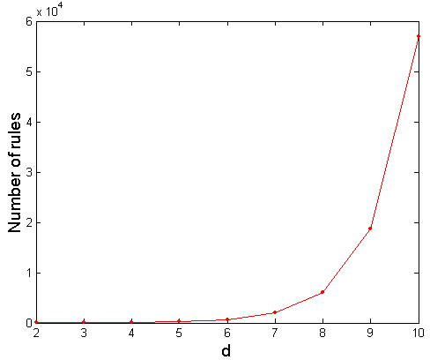
Computational Complexity
Given d unique items:
Total number of itemsets = 2^{d}
Total number of possible association rules:
If d=6, R = 602 rules

Slide 12
Frequent Itemset Generation Strategies
Reduce the number of candidates (M)
Complete search: M=2^{d}
Use pruning techniques to reduce M
Reduce the number of transactions (N)
Reduce size of N as the size of itemset increases
Used by DHP and vertical-based mining algorithms
Reduce the number of comparisons (NM)
Use efficient data structures to store the candidates or transactions
No need to match every candidate against every transaction

Slide 13
Reducing Number of Candidates
Apriori principle:
If an itemset is frequent, then all of its subsets must also be frequent
Support of an itemset never exceeds the support of its subsets
This is known as the anti-monotone property of support

Slide 14
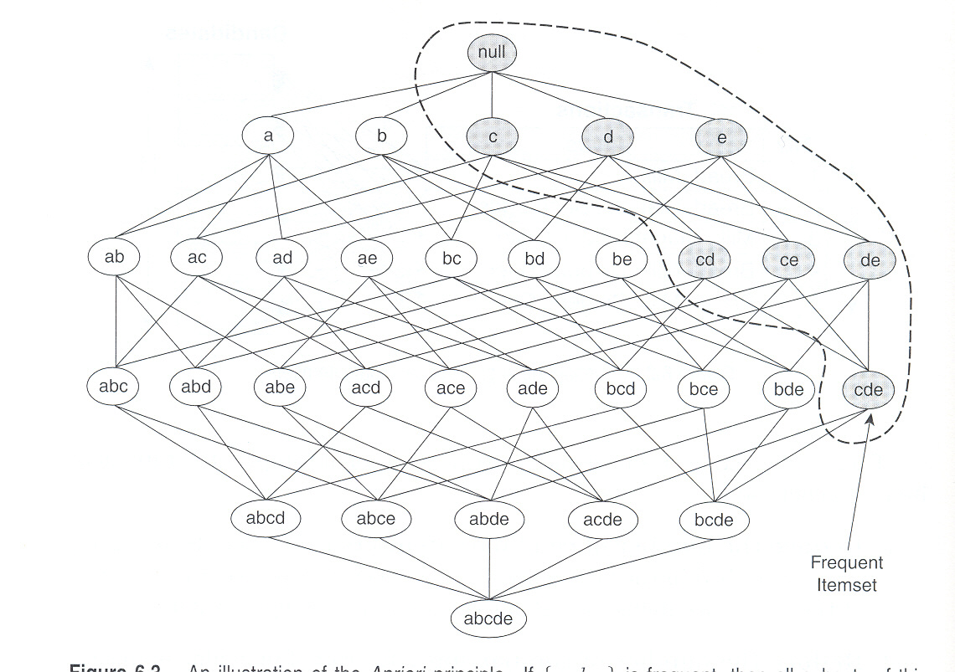
Illustrating Apriori Principle

Slide 15
Illustrating Apriori Principle
Found to be Infrequent
Pruned supersets

Slide 16
Illustrating Apriori Principle
Items (1-itemsets)
Minimum Support = 3
If every subset is considered,
⁶C₁ + ⁶C₂ + ⁶C₃
6 + 15 + 20 = 41
With support-based pruning,
6 + 6 + 4 = 16

Slide 17
Illustrating Apriori Principle
Items (1-itemsets)
Minimum Support = 3
If every subset is considered,
⁶C₁ + ⁶C₂ + ⁶C₃
6 + 15 + 20 = 41
With support-based pruning,
6 + 6 + 4 = 16

Slide 18
Illustrating Apriori Principle
Items (1-itemsets)
Pairs (2-itemsets)
(No need to generate candidates involving Coke or Eggs)
Minimum Support = 3
If every subset is considered,
⁶C₁ + ⁶C₂ + ⁶C₃
6 + 15 + 20 = 41
With support-based pruning,
6 + 6 + 4 = 16

Slide 19
Illustrating Apriori Principle
Items (1-itemsets)
Pairs (2-itemsets)
(No need to generate candidates involving Coke or Eggs)
Minimum Support = 3
If every subset is considered,
⁶C₁ + ⁶C₂ + ⁶C₃
6 + 15 + 20 = 41
With support-based pruning,
6 + 6 + 4 = 16

Slide 20
Illustrating Apriori Principle
Items (1-itemsets)
Pairs (2-itemsets)
(No need to generate candidates involving Coke or Eggs)
Minimum Support = 3
Triplets (3-itemsets)
If every subset is considered,
⁶C₁ + ⁶C₂ + ⁶C₃
6 + 15 + 20 = 41
With support-based pruning,
6 + 6 + 4 = 16

Slide 21
Illustrating Apriori Principle
Items (1-itemsets)
Pairs (2-itemsets)
(No need to generate candidates involving Coke or Eggs)
Minimum Support = 3
Triplets (3-itemsets)
If every subset is considered,
⁶C₁ + ⁶C₂ + ⁶C₃
6 + 15 + 20 = 41
With support-based pruning,
6 + 6 + 4 = 16
6 + 6 + 1 = 13

Slide 22
Apriori Algorithm
F_{k}: frequent k-itemsets
L_{k}: candidate k-itemsets
Algorithm
Let k=1
Generate F₁ = {frequent 1-itemsets}
Repeat until F_{k} is empty
Candidate Generation: Generate L_{k+1} from F_{k}
Candidate Pruning: Prune candidate itemsets in L_{k+1} containing subsets of length k that are infrequent
Support Counting: Count the support of each candidate in L_{k+1} by scanning the DB
Candidate Elimination: Eliminate candidates in L_{k+1} that are infrequent, leaving only those that are frequent => F_{k+1}

Slide 23
Factors Affecting Complexity
Choice of minimum support threshold
lowering support threshold results in more frequent itemsets
this may increase number of candidates and max length of frequent itemsets
Dimensionality (number of items) of the data set
more space is needed to store support count of each item
if number of frequent items also increases, both computation and I/O costs may also increase
Size of database
since Apriori makes multiple passes, run time of algorithm may increase with number of transactions
Average transaction width
transaction width increases with denser data sets
This may increase max length of frequent itemsets and traversals of hash tree (number of subsets in a transaction increases with its width)

Slide 24
Rule Generation
Given a frequent itemset L, find all non-empty subsets f ⊂ L such that f → L – f satisfies the minimum confidence requirement
If {A,B,C,D} is a frequent itemset, candidate rules:
ABC →D, ABD →C, ACD →B, BCD →A, A →BCD, B →ACD, C →ABD, D →ABC AB →CD, AC → BD, AD → BC, BC →AD, BD →AC, CD →AB,
If |L| = k, then there are 2^{k} – 2 candidate association rules (ignoring L → ∅ and ∅ → L)

Slide 25
Rule Generation for Apriori Algorithm
Lattice of rules
Low Confidence Rule
Pruned Rules

Slide 26
Compact Representation of Frequent Itemsets
Some itemsets are redundant because they have identical support as their supersets
Need a compact representation

Slide 27
Maximal Frequent Itemset
An itemset is maximal frequent if none of its immediate supersets is frequent
Maximal Itemsets
Infrequent Itemsets
Border

Slide 28
Closed Itemset
An itemset is closed if none of its immediate supersets has the same support as the itemset
An itemset is not closed if at least one of its immediate supersets has the same support

Slide 29
Maximal vs Closed Itemsets
Transaction Ids
Not supported by any transactions

Slide 30
Maximal vs Closed Frequent Itemsets
Minimum support = 2
Closed but not maximal
Closed and maximal
# Closed = 9
# Maximal = 4

Slide 31
Maximal vs Closed Itemsets

